Slide 1
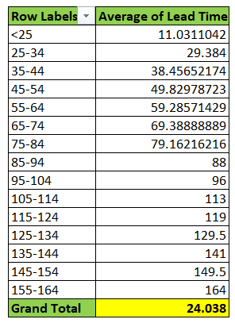
1. AVERAGE LEAD TIME
Inference: From the given data, the difference between the lead times are found and they are converted into a pivot table to find the average
The average lead time between the request date and the completion date for all work orders is 24.038.

Slide 2
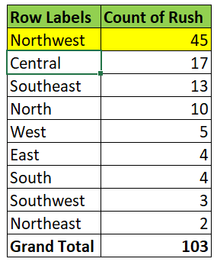
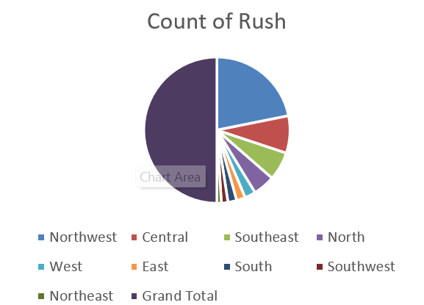
2. Highest number of Rush Jobs
Observation:
It is observed from the data that the total number of rush jobs is 103 and the Northwest District has the highest number of rush jobs

Slide 3
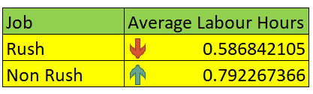
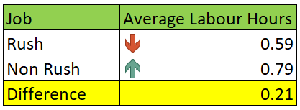
3. Difference of Average Labour Hours
Observation:
From the given data, it is observed that the average labour hours increases in case of non-rush jobs and decreases in case of rush jobs. The difference of average labour hours between the rush and the non-rush jobs is 0.21 hours.

Slide 4
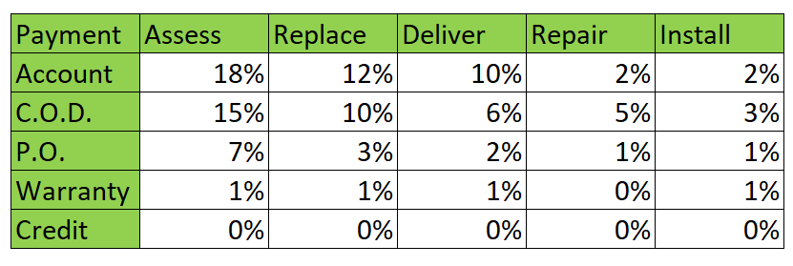
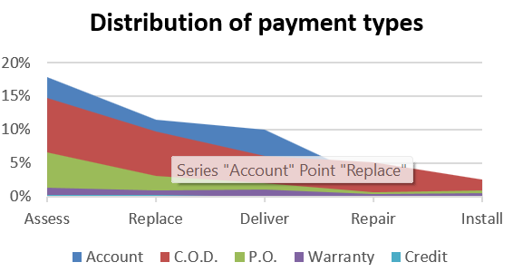
4. Distribution of payment types
Observation:
It is observed from the data that the payment type Account holds the majority transactions than all other type. The distribution of payment types across various services is given below as a table.

Slide 5
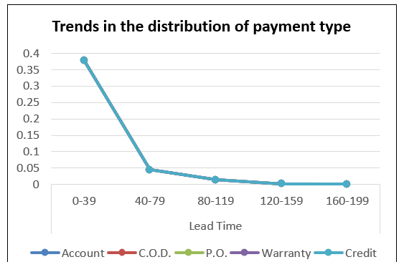
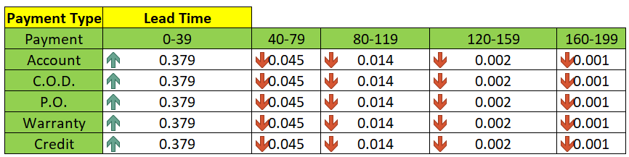
5. Trends in the distribution of payment types
Inference:
It is observed from the data and found the
trends in the distribution of payment types over
The lead time. The trend of Payment decreases
as the lead time increases.

Slide 6
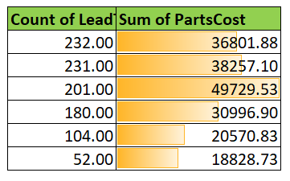
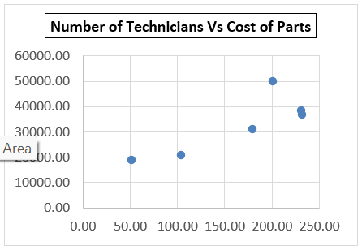
6. Number of Technicians Vs Cost of Parts
Observation:
From the given data it is observed that
there is a relationship between the number of
Technicians and the cost of parts. The relationship between them is when the number of lead technicians increases, the cost of the parts also increases.

Slide 7
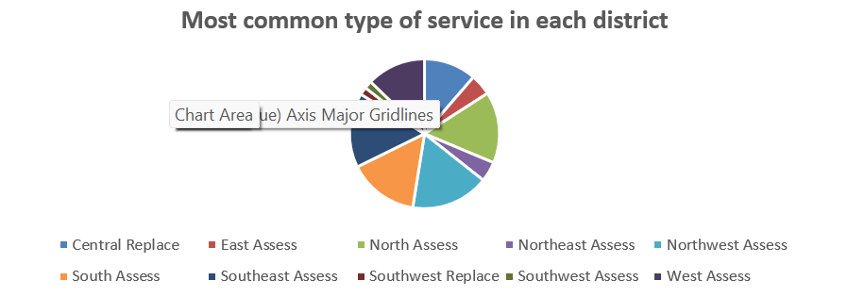
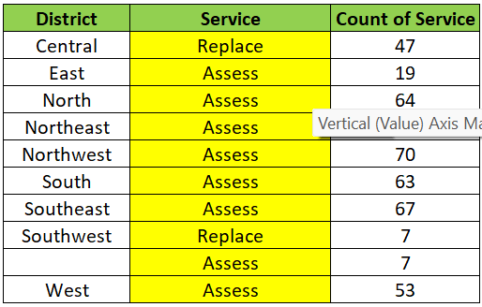
7. Most common type of service requested
The visual representation of most common type of service requested in each district is given below:

Slide 8
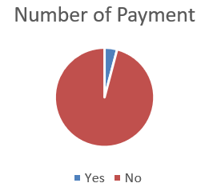

8. Payment type Vs Wtylbr

Slide 9
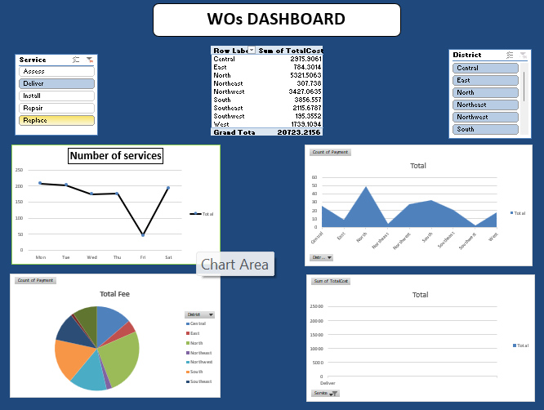
9. Dashboard

